Slide 1
Bayesian Classifiers in Python
Adam McElhinney
MCS 507
November 5, 2012
Notes:
This template can be used as a starter file for presenting training materials in a group setting.
Sections
Right-click on a slide to add sections. Sections can help to organize your slides or facilitate collaboration between multiple authors.
Notes
Use the Notes section for delivery notes or to provide additional details for the audience. View these notes in Presentation View during your presentation.
Keep in mind the font size (important for accessibility, visibility, videotaping, and online production)
Coordinated colors
Pay particular attention to the graphs, charts, and text boxes.
Consider that attendees will print in black and white or grayscale. Run a test print to make sure your colors work when printed in pure black and white and grayscale.
Graphics, tables, and graphs
Keep it simple: If possible, use consistent, non-distracting styles and colors.
Label all graphs and tables.

Slide 2
Agenda
Overview of Classification Problems
Definition
Applications
Simple Example (Classify Dogs and Cats)
Introduction to Bayes Theorem
Background theory
Example Usage (Da’ Bears)
Revisit Simple Example, Bayesian Style!
Implementing Bayesian Classifiers in Python
Background of Orange Machine Learning Software and Libraries
Brief tour of GUI
Illustrative Example
Problem Overview
Building the Classifier
Assessing Classifier Performance
Limitations of Bayesian Classifiers
Real World Example
Conclusion
Additional Areas of Exploration
Questions

Slide 3
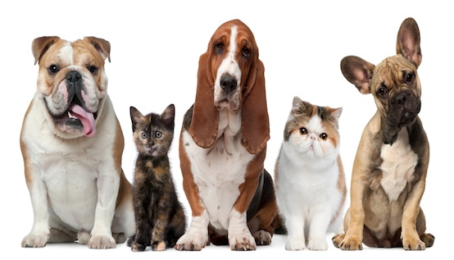
Overview of Classification Problems: Definition
Goal: Identify to which set of categories a new observation belongs

Slide 4
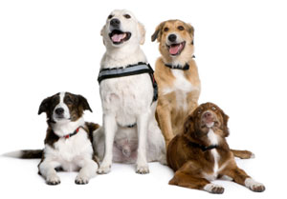
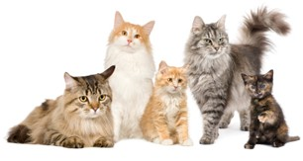
Overview of Classification Problems: Definition
Training data set: A set of data containing the explanatory variables, whose membership is known
Group 1
Group 2
Training Data Set

Slide 5
Overview of Classification Problems: Definition
Classifier: The mathematical function created based on a training data set, used to assign membership for new observations
Feature | Cats | Dogs
Size | Small | Large
Ears | Pointed | Floppy
Temperament | Aloof | Loving
Tail | Erect | Wagging
Snout | Short | Long

Slide 6



Overview of Classification Problems: Definition
Feature | Cats | Dogs
Size | Small | Large
Ears | Pointed | Floppy
Temperament | Aloof | Loving
Tail | Erect | Wagging
Snout | Short | Long
Training Data
Build Classifier
Feature | Cats | Dogs
Size | Small | Large
Ears | Pointed | Floppy
Temperament | Aloof | Loving
Tail | Erect | Wagging
Snout | Short | Long
New Observation
Run Classifier
Predict Group

Slide 7

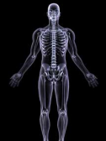


Overview of Classification Problems: Applications
Computer Vision
Medical Imaging
Speech Recognition
Credit Scoring
Notes:
These are some examples of classification problems that have been in the news lately.
Computer vision: this is where algorithms are developed to try and translate computer images into usable information about the surroundings. The most famous example of this in practice is Google’s attempts to develop driver-less cars.
Medical imaging: whereas in the past, every cat scan and x-ray was manually reviewed by a medical practioner, now algorithms are supplementing humans to identify broken bones, tumors, etc.
Speech recognition: the most famous example of this is the SIRI person assistant feature on the iphone, which takes your spoken word and translates it (tries to, at least) into a query
Credit scoring: every credit card, mortgage, or student loan you apply for, it is likely that sophisticated algorithms are predicting your probability of being a good or bad credit risk

Slide 8
Introduction to Bayes Theorem: Background theory
Bayesian
Support Vector Machines
Decision Trees
Neural Networks
Classification Algorithms
Notes:
Bayesian Classifiers are a member of this large group of algorithms, call Classification Algorithms

Slide 9

Introduction to Bayes Theorem: Background theory
Bayesian Classifiers rely on Bayes theorem, which states for two events A and B:

Slide 10


Introduction to Bayes Theorem: Example Usage
Scenario:
There are two football teams on TV today, the Chicago Bears and the Green Bay Packers.
Since the Chicago Bears are such a superior team, they are winners 80% of the time and therefore losers 20% of the time. Whereas the Green Bay packers, being inferior in every way, are winners a mere 10% of the time and therefore losers 90% of the time.
Now suppose upon turning on ESPN to catch the game scores, you hear them refer to a winning team, but cannot make out the name of the team.
You would like to know which team they were discussing, but you know that they were either discussing the Chicago Bears or the Green Bay Packers with equal chance.

Slide 11



Introduction to Bayes Theorem: Example Usage

Slide 12
Introduction to Bayes Theorem: Example Usage
Bayesian Classifiers use this theorem to predict the probability of a new observation belonging to a certain class
The observation is then assigned the class to which the classifier predicts has the observation has the highest chance of being a member

Slide 13
Overview of Classification Problems: Definition
Feature | Cats | Dogs
Size | P(Small)= 80% P(Large)= 20% | P(Small)= 30% P(Large)= 70%
Ears | P(Pointed)= 90% P(Floppy)= 10% | P(Pointed)= 10% P(Floppy)= 90%
Temperament | P(Aloof)= 60% P(Loving)= 40% | P(Aloof)= 10% P(Loving)= 90%
Tail | P(Erect)=75% P(Wagging)= 25% | P(Erect)= 40% P(Wagging)= 60%
Snout | P(Short)= 80% P(Long)= 20% | P(Short)= 20% P(Long)= 80%
Training Data
Build Classifier

Slide 14
Overview of Classification Problems: Definition
Feature | Cats | Dogs
Size | P(Small)= 80% P(Large)= 20% | P(Small)= 30% P(Large)= 70%
Ears | P(Pointed)= 90% P(Floppy)= 10% | P(Pointed)= 10% P(Floppy)= 90%
Temperament | P(Aloof)= 60% P(Loving)= 40% | P(Aloof)= 10% P(Loving)= 90%
Tail | P(Erect)=75% P(Wagging)= 25% | P(Erect)= 40% P(Wagging)= 60%
Snout | P(Short)= 80% P(Long)= 20% | P(Short)= 20% P(Long)= 80%
New Observation
Run Classifier
Predict Group
New Observation is a Dog

Slide 15


Implementing Bayesian Classifiers in Python
Orange Data Mining Fruitful & Fun:
Open-source machine learning and data mining tool
Developed by the Bioinformatics Laboratory at the Faculty of Computer and Information Science in the University of Ljubljana, Slovenia
Provides GUI as well as extensive Python libraries
Utilizes C++ for computation, resulting in reasonably fast processing of large data sets
Large amount of documentation and extensive developer community

Slide 16
Implementing Bayesian Classifiers in Python
Orange supports the following classifiers:
Naïve Bayes
Support vector machines
Logistic Regression
Classification Trees
CN2 Algorithm
K-Nearest Neighbors

Slide 17
Illustrative Example
Goal: Predict the color of the dots

Slide 18
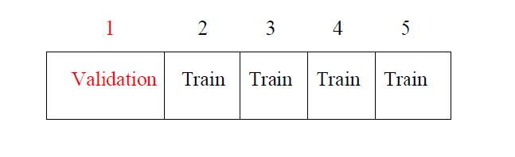
Illustrative Example
Utilized k-fold cross validation to train and score classifier
data is divided into roughly k equal parts (k being specified by the user at the outset)
model is then t using the observations in k-1 parts
model is then used to score the k-th part
process is repeated k-times, using a dierent partition each time

Slide 19
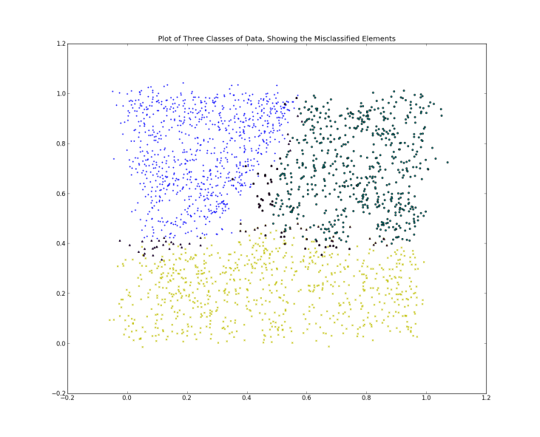
Illustrative Example
Notes:
Small number of misclassified observations (represented as dark triangles)
Errors lie the boundaries between the three groups

Slide 20
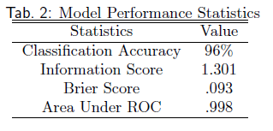
Illustrative Example
Classification Accuracy: % of observations in test group that were accurately classified
Information Score (Kononenko and Bratko (1991)): Beyond scope of presentation
Brier Score: Difference between predicted probability of an outcome and actual probability of that outcome
Area Under ROC: Probability that a classifier will calculate the probability of an object belonging to a certain group as higher than the probability of an object of another group
Notes:
Example of ROC
- Take a green observation (x₁) and a red observation (x₂)
- Compute the probability of each observation being green
- If the probability of x1 being green is greater than the probability of x2 being green, then assign a 1, otherwise 0
- Repeat and average the results

Slide 21
Illustrative Example
Limitations of Bayesian Classifiers:
Most rely on strict assumption of independence between variables (Naïve)
Models that do not rely on independence assumption can be quite complex

Slide 22
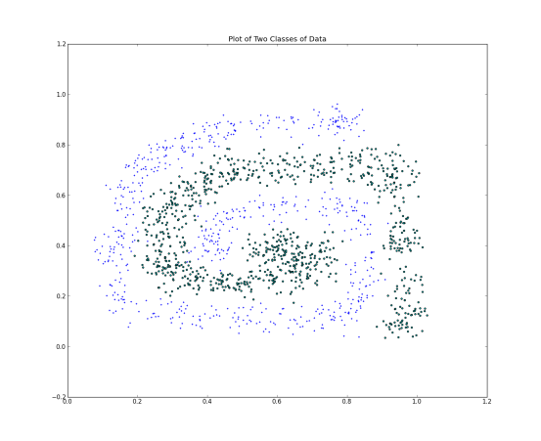
Illustrative Example
X and Y coordinates are not independent

Slide 23
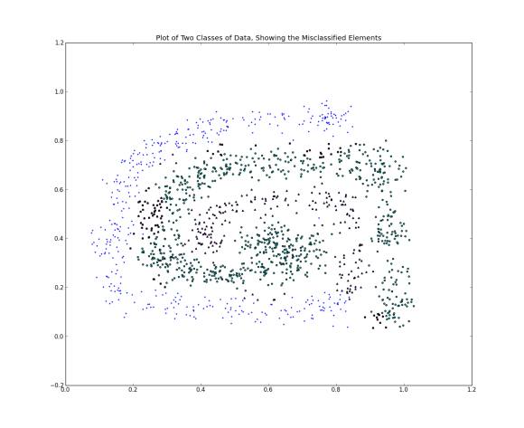
Illustrative Example
Model performs very poorly due to violation of independence assumption

Slide 24
Real World Example
Objective: Predict whether income exceeds $50K/yr based on 1994 census data
Data Set Characteristics: | Multivariate | Number of Instances: | 48842 | Area: | Social
Attribute Characteristics: | Categorical, Integer | Number of Attributes: | 14 | Date Donated | 1996-05-01
Associated Tasks: | Classification | Missing Values? | Yes | Number of Web Hits: | 272000

Slide 25
Real World Example
Variables:
Income: >50k, <= 50k
Age
Workclass: Private, Self-emp-not-inc, Self-emp-inc, Federal-gov, Local-gov, State-gov, Without-pay, Never-worked.
Fnlwgt: Weighting to reflect sample bias
Education: Bachelors, Some-college, 11th, HS-grad, Prof-school, Assoc-acdm, Assoc-voc, 9th, 7th-8th, 12th, Masters, 1st-4th, 10th, Doctorate, 5th-6th, Preschool.
Education-num: Number of Years of School.
Marital-status: Married-civ-spouse, Divorced, Never-married, Separated, Widowed, Married-spouse-absent, Married-AF-spouse.
Ocupation: Tech-support, Craft-repair, Other-service, Sales, Exec-managerial, Prof-specialty, Handlers-cleaners, Machine-op-inspct, Adm-clerical, Farming-fishing, Transport-moving, Priv-house-serv, Protective-serv, Armed-Forces.
Relationship: Wife, Own-child, Husband, Not-in-family, Other-relative, Unmarried.
Race: White, Asian-Pac-Islander, Amer-Indian-Eskimo, Other, Black.
Sex: Female, Male.
Capital-gain
Capital-loss
Hours-per-week
Native-country

Slide 26
Real World Example
Notes:
Data was not cleaned to test robustness of Naïve Bayes
No variable selection techniques were employed
Data contains missing values
Data contains a mix of categorical and continuous variables
No prior knowledge about the distribution of the variables was used before model was build
“True” machine learning problem without any human intervention

Slide 27
Real World Example
K-fold cross validation used to fit and score model (k=10)
< 1 minute execution time to import data, build classifier and score model
Model predicts 82% of observations correctly with AUC=.899!

